Slide 1


AcademiMate An AI-Powered Chatbot for California State University, Los Angeles
Notes:
Hi all,
For our capstone project we created a chatbot for CalStateLA to help students, seasoned or new, in navigating campus-life.

Slide 2

California State University, Los Angeles
AISHWARYA Gupta
RAHUL BHOGALE
YULIN HE
Gentre ThomseN
Notes:
Our team consists of Ash Gupta, Rahul Bhogale, Yulin He, and myself, Gentre Thomsen. We are all MSIS majors currently in or quickly approaching our final semesters in the program.

Slide 3

Introduction
Located in Los Angeles, California State University, Los Angeles stands is a beacon of higher education, committed to fostering academic excellence and student success
We introduced an innovative AI-powered chatbot named AcademiMate, designed specifically to cater to the diverse needs of students, both academically and non-academically
The AcademiMate chatbot represents a comprehensive solution to address the myriad challenges faced by students at CSULA
Notes:
There are countless resources available on campus at CalStateLA. This diverse and complex pool can be overwhelming to navigate. What single resource can provide guidance to the errant Golden Eagle? Welcome to AcademiMate, by CalStateLA! Perhaps you’re aware that CalStateLA has laptops available for student use, but you’re not sure where to make inquiry in order to acquire one. Maybe you’ve lost a personal item on campus and are uncertain who you should contact for help. AcademiMate is there to point you in the right direction. From the lost and found to the GET portal to scheduled events, AcademiMate is available at any hour to assist you in locating and leveraging Golden Eagle resources.

Slide 4

Why does CSULA need a chatbot?
Ease of use
Cost effective
24/7 Availability
Time saved pouring through inconsistent and elusive FAQs
Notes:
So you might be asking yourself, “Why do I need a chatbot?”
Well truthfully, you don’t NEED a chatbot. People got along just fine prior to the advent of ChatGPT, but let’s face it: it’s just convenient. AcademiMate doesn’t require lunch breaks or sleep: It’s responsive anytime, anywhere… provided you have an internet connection. AcademiMate is easy to use and can guide you expediently to the information you seek. Have you ever poured through the plethora of disparate FAQs CalStateLA has for student resources? Well… we have. It’s a labyrinth. AcademiMate spares you all that and more.

Slide 5

How does it work?
AcademiMate is an innovative AI-powered chatbot designed to comprehensively assist CSULA students throughout their academic journey
It addresses challenges related to course registration, academic advising, campus resources, and university policies
The app aims to provide timely assistance, connect students to appropriate services, and contribute significantly to their overall success at CSULA
Notes:
So how does it work? I’m glad you asked! Various technologies were tested and rejected before we landed on a largely-Azure-centric solution. The UI can be incorporated into any web page, as it is served up via an API (sharepoint as an example).

Slide 6


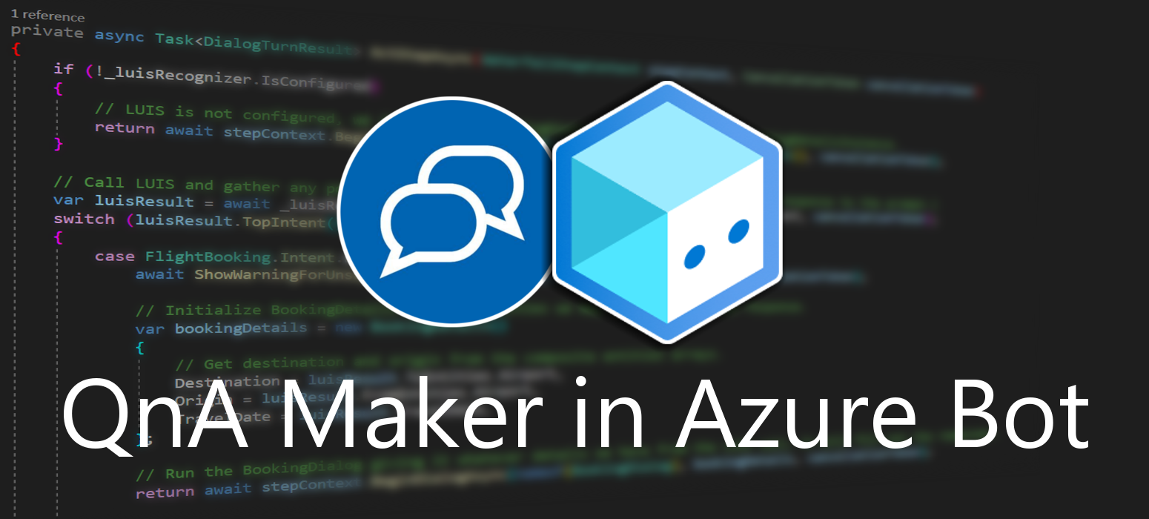
But really, how does it work?
Notes:
AcademiMate is driven largely by the Azure Language Studio AI framework. The pivotal role of Natural Language Processing (NLP) through tools like QnA Maker and Language Studio was paramount in elevating the chatbot's ability to comprehend and respond effectively to user queries. This robust NLP foundation laid the groundwork for a more intelligent and user-friendly interaction. Incorporating machine learning algorithms within the QnA Maker took the functionality to the next level. These algorithms were not only instrumental in tailoring personalized recommendations but also played a key role in the continuous enhancement of the system's responsiveness. By learning from user interactions, AcademiMate evolved to better understand and cater to individual needs. The design process was marked by an iterative approach, incorporating user testing to fine-tune and optimize the overall user experience. This user-centric methodology ensured that the chatbot not only met but exceeded user expectations, providing a seamless and intuitive interaction. Furthermore, the utilization of Language Studio extended beyond NLP to include web scraping capabilities. This facilitated the extraction of relevant and up-to-date information from the internet, ensuring that AcademiMate was equipped with the latest data for more accurate responses. To enhance precision and user confidence, the system was designed to present options with high confidence levels. In instances where the confidence level dipped below 20%, a thoughtful feature was incorporated. Users were empowered to add custom messages, enriching the system's knowledge base and ensuring accurate responses even in scenarios where standard confidence levels were suboptimal. In essence, AcademiMate reflects a harmonious blend of advanced AI technologies, user-centric design principles, and a commitment to continuous improvement, all orchestrated to deliver a cutting-edge and user-friendly chatbot experience.

Slide 7

Demonstration
Notes:
I’ll now hand off to Rahul for a live demonstration of AcademiMate. Rahul, take it away…

Slide 8

Challenges
While AcademiMate shows great promise, limitations include potential challenges in handling highly specific queries and the need for ongoing refinement to improve contextual understanding
Notes:
Language / text / slang barrier
Tech barrier – web scrapping
Ai bot – training n training, enhancing dataset, mapping keywords n answers to ques,
accurracy

Slide 9

Future Vision
Continuation of this project could involve refining the chatbot's capabilities, expanding its knowledge base, and incorporating feedback from a broader user base
Notes:
AcademiMate’s capabilities are incredibly promising and due to the scalable architecture, it will only get better with use. Further data collection, training, and adjustments would be our next steps. We expect that coupled with actual usage will yield a truly remarkable chatbot experience.

Slide 10

Conclusion
AcademiMate demonstrates the potential of AI-powered chatbots in addressing the multifaceted challenges students face during their academic journey
The project signifies a step toward enhancing student satisfaction and success at CSULA
Notes:
AcademiMate would be of great help to students in reolsving their daily challenges, would also save tones of time and effort.
We had a great time putting this project together and couldn’t be more pleased with the outcome. The project signifies a step toward enhancing student satisfaction and success at CSULA.

Slide 11

Acknowledgements
Special thanks to .
Cedrick N.
Kristofer Acio (H&rl)
Renee Gonzales (H&RL)
Notes:
We want to acknowledge and thank Professor Ngalande for his guidance and feedback, as well as SomeOtherPerson for TheThingsTheyDid. Lastly…

Slide 12

Thank you all for your time and attention!
Notes:
… we want to thank you all for taking this ride with us.

